Slide 1

Project Title - Healthcare Analytics for Doctor Visits
Student Name – Gangode Prathmesh Raghunath
AICTE ID – STU68f9f4033b6691761211395

Slide 2

PROBLEM STATEMENT
Healthcare data contains valuable information about patients, health conditions, insurance coverage, and healthcare utilization. However, identifying patterns in doctor visits from raw healthcare data can be difficult. This project aims to analyze healthcare data to understand the factors associated with doctor visits and use statistical analysis and machine learning to identify important patterns and relationships.

Slide 3
Project Description
This project, Healthcare Analytics for Doctor Visits, analyzes a dataset containing, healthcare records and variables related to doctor visits, demographic information, health conditions, income, insurance coverage, and chronic conditions.
The project begins with data loading, cleaning, validation, and exploratory data analysis. Different visualizations are used to study the distribution of doctor visits and relationships between doctor visits, illness, insurance, and other healthcare variables.

Slide 4

WHO ARE THE END USERS?
Healthcare data analysts
Healthcare researchers
Hospitals and healthcare organizations
Healthcare management teams
Students and researchers working in healthcare analytics
Data science and machine learning learners

Slide 5

Technology Used
    Python
    Pandas
    NumPy
    Matplotlib
    Seaborn
    Google Colab
    Poisson Regression

Slide 6
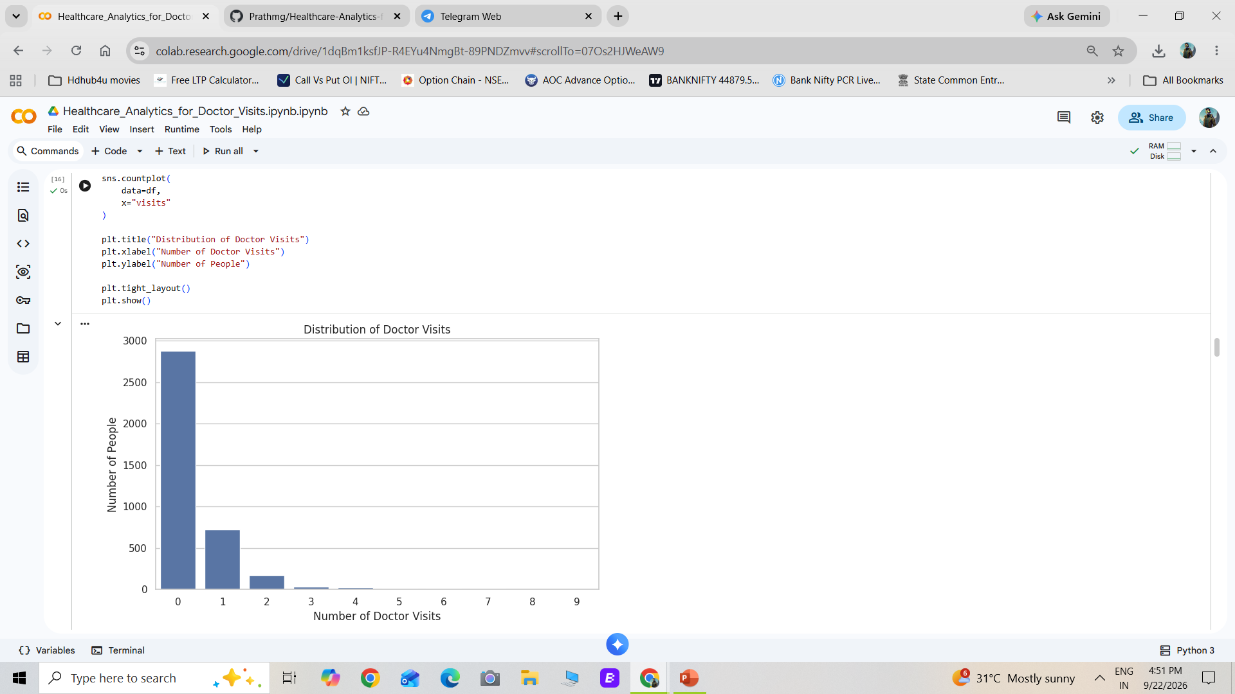
RESULTS
Demo Link

Slide 7
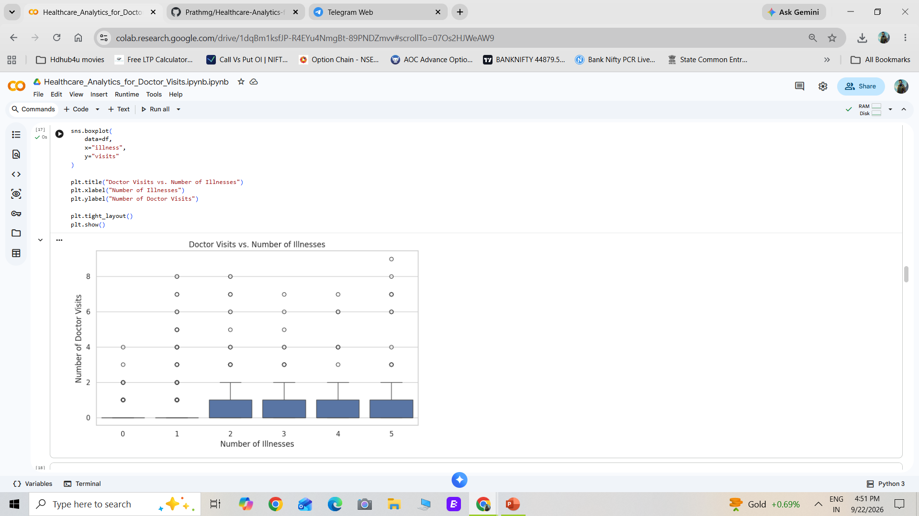
Results

Slide 8
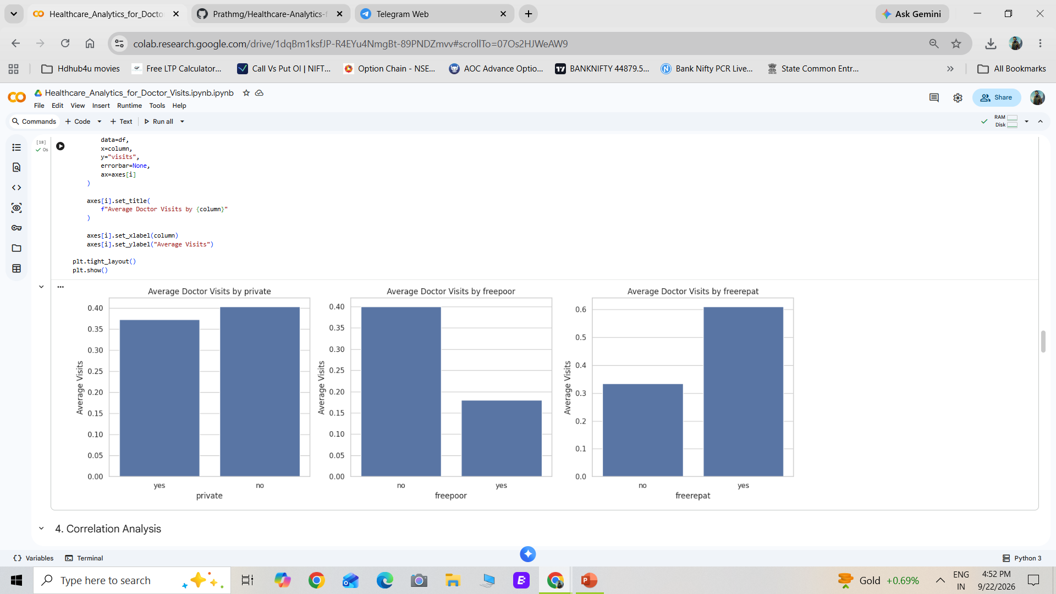
Results

Slide 9
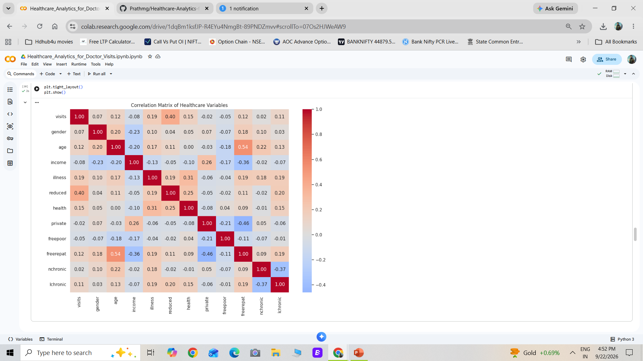
Results

Slide 10
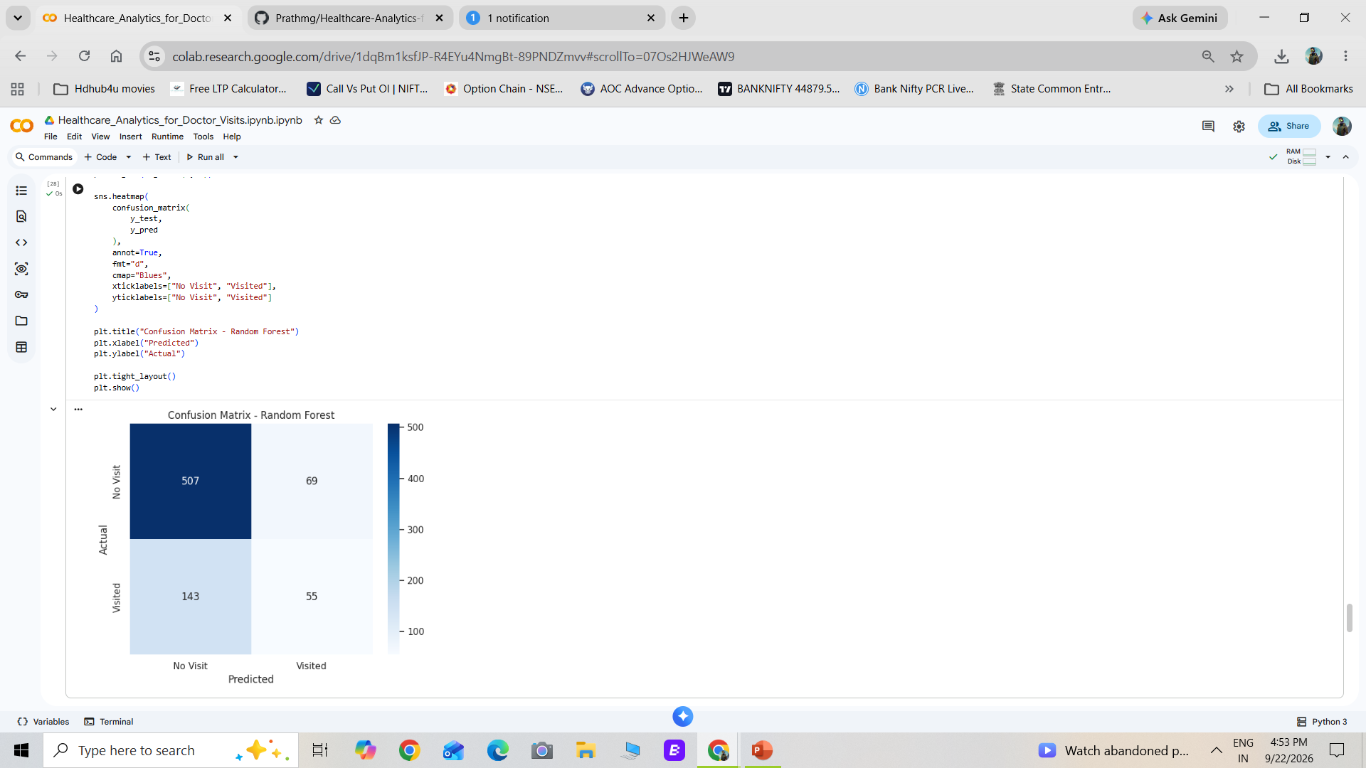
Results

Slide 11
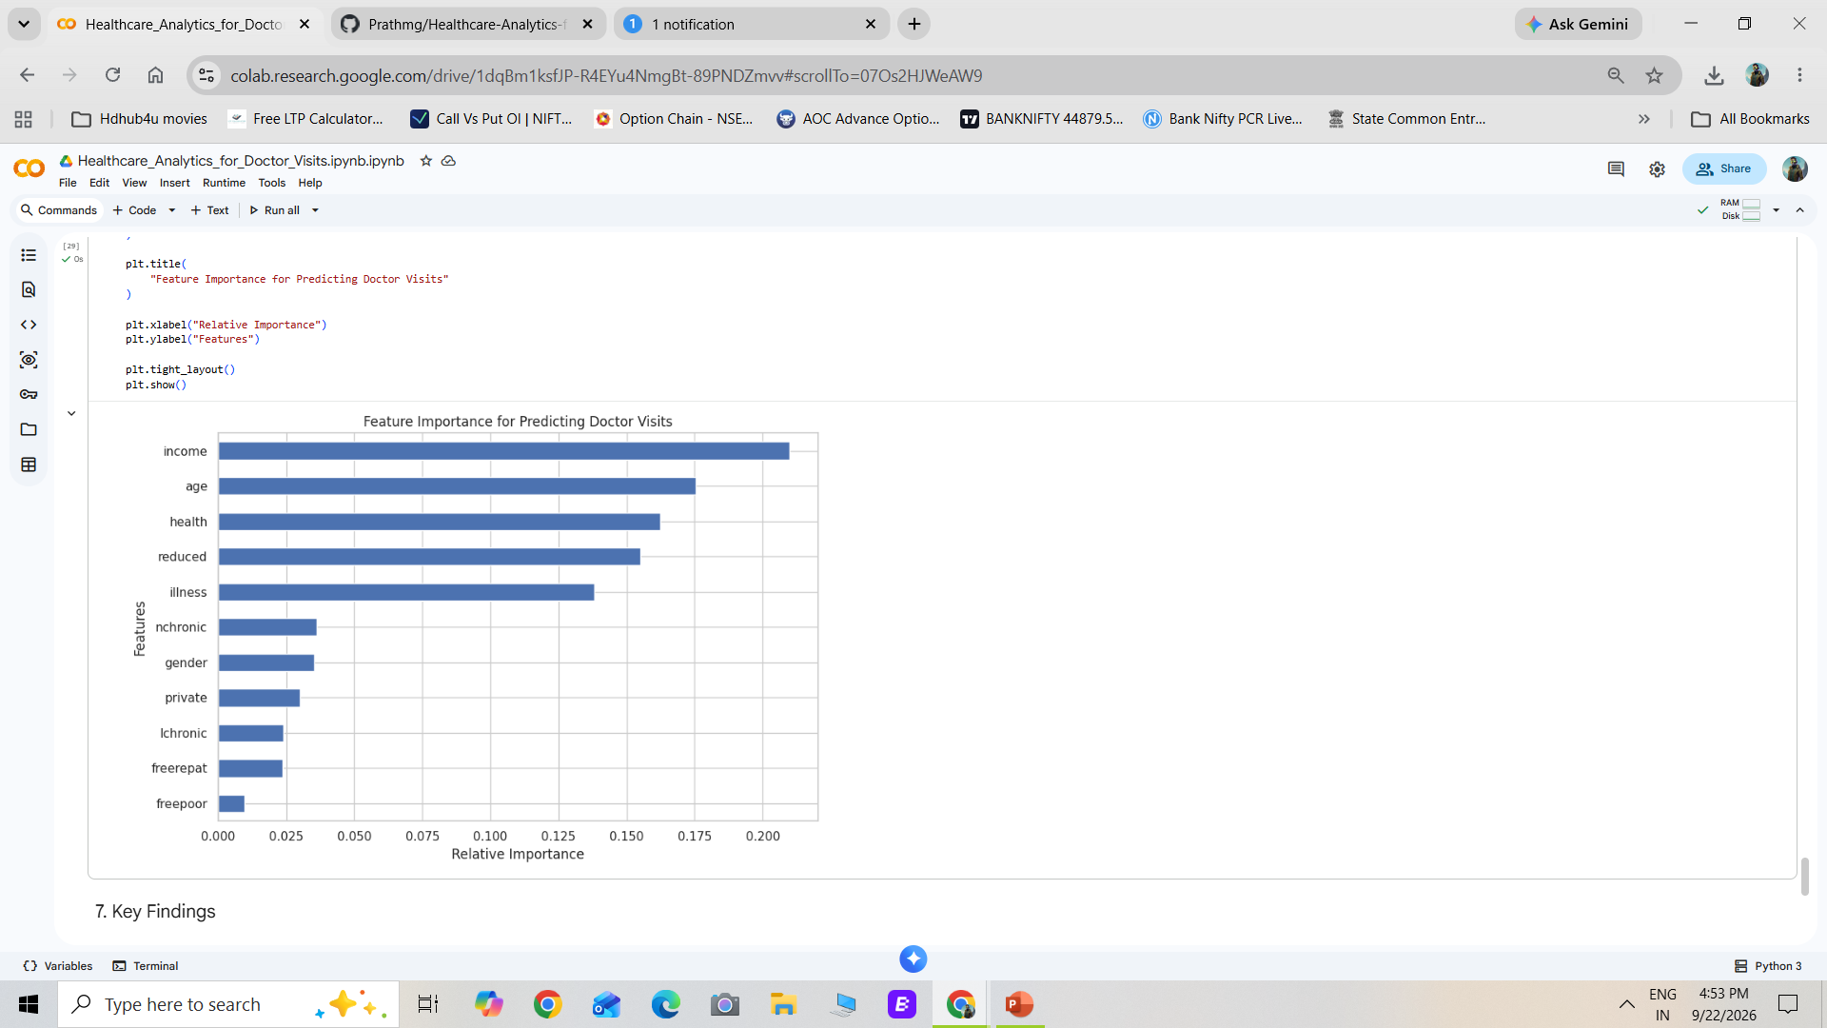
Results

Slide 12
GitHub- https://github.com/Prathmg/Healthcare-Analytics-for-Doctor-Visits
Student Name – Gangode Prathmesh Raghunath
AICTE ID – STU68f9f4033b6691761211395

Slide 13
Thank you
.
.

